Slide 1
ARL Notice List Project
CS347 Final Presentation
Steven Ritchie, Andrew Nguyen

Slide 2
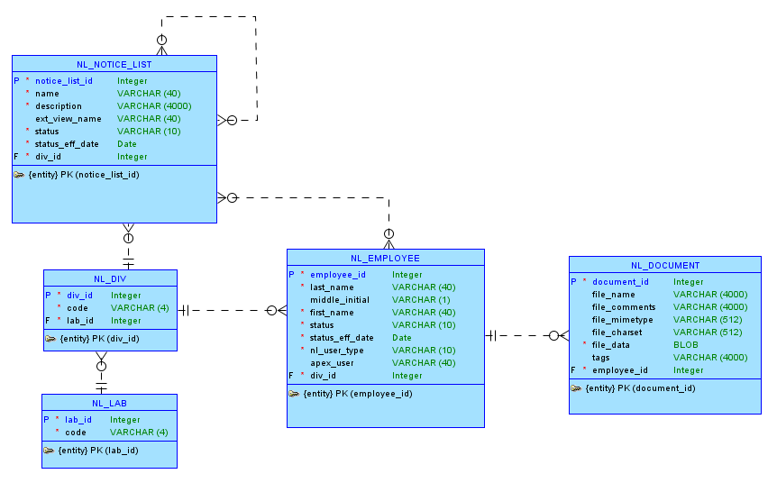
Conceptual Model
NL_EMPLOYEE, NL_DIV, NL_LAB are read-only tables

Slide 3
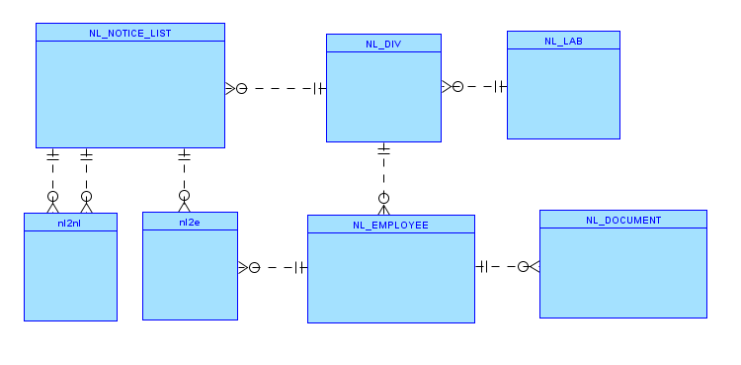
Logical Model (Intermediate)
Convert the two M:N relationships into two junction tables

Slide 4
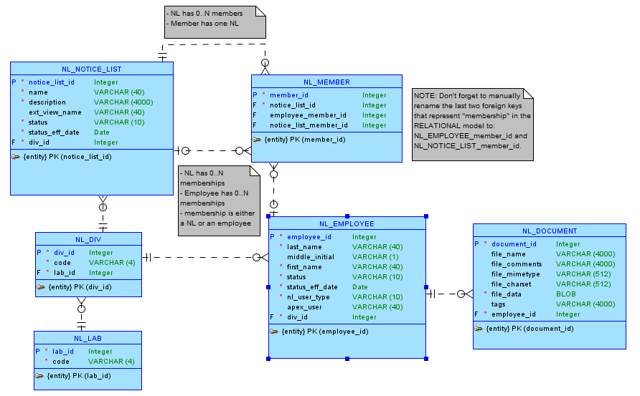
Logical Model (Final)
To match the schema given by ARL, the NL_MEMBER junction table combines what was two junction tables (previous slide) into one table where EITHER employee_member_id OR notice_list_member_id is used.

Slide 5
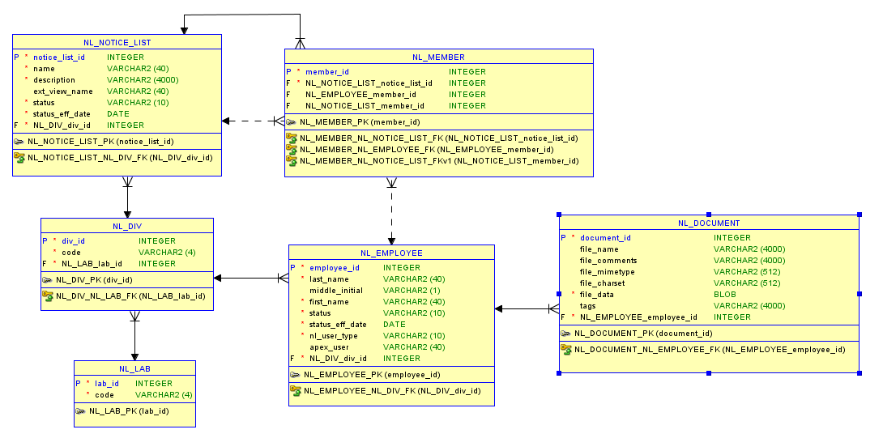
Logical Model Relational

Slide 6
APEX Application
URL https://apex.oracle.com/pls/apex/f?p=90854:LOGIN_DESKTOP:106205508786492:::::
ACCOUNTS
ADMIN
user: nladmin, pwd: nladmin
STANDARD
user: nlstandard, pwd: nlstandard
BASIC
user: nlbasic, pwd: nlbasic
NONE
user: nlnone, pwd: nlnone

Slide 7
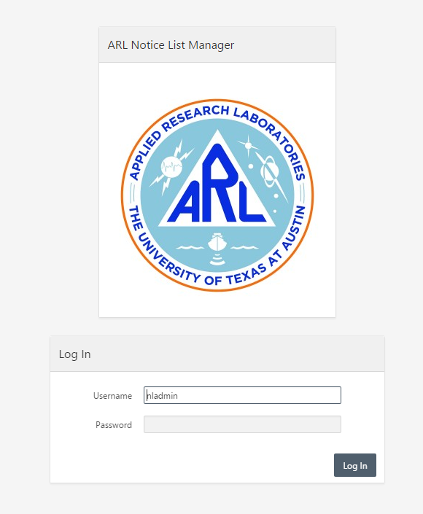
Login Page
Uses APEX authentication and links APEX users to NL_EMPLOYEES

Slide 8
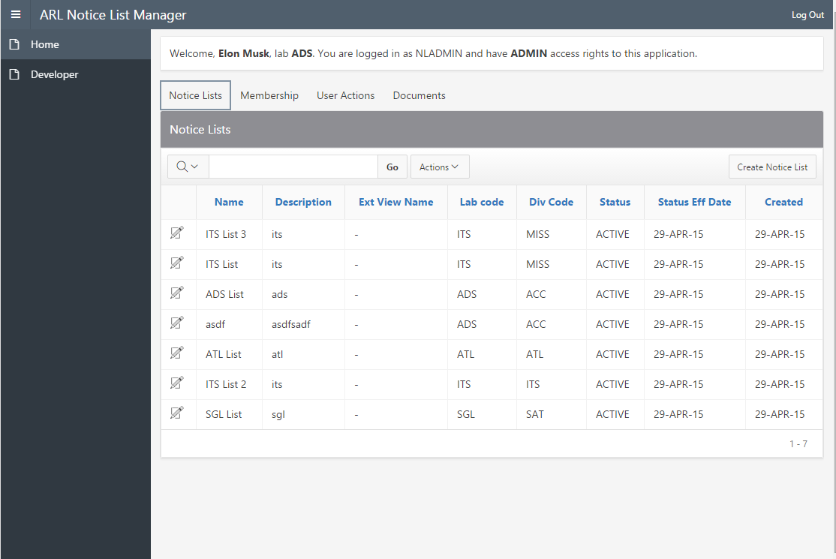
Notice List Tab
ADMIN only, manage notice lists

Slide 9
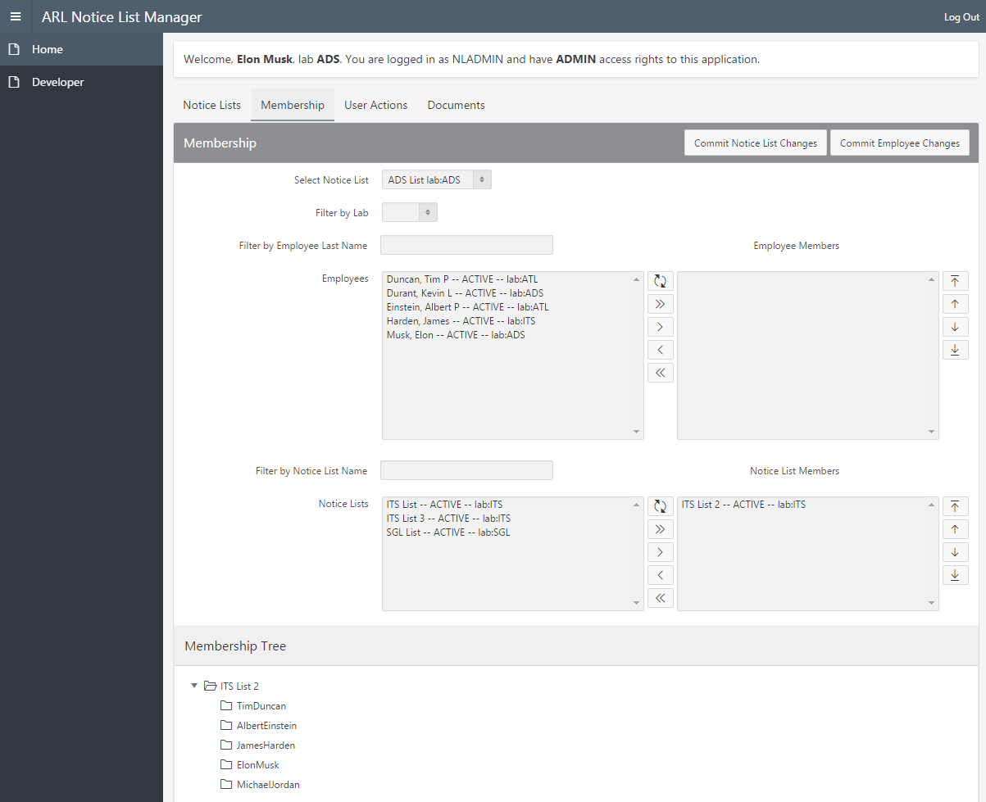
Members Tab
Manage memberships
Filter by last name
Filter by list name
ADMINS can control any list
STANDARD users can only control lists in their lab
Tree view of list membership
Multiselect vis shuttle controls

Slide 10
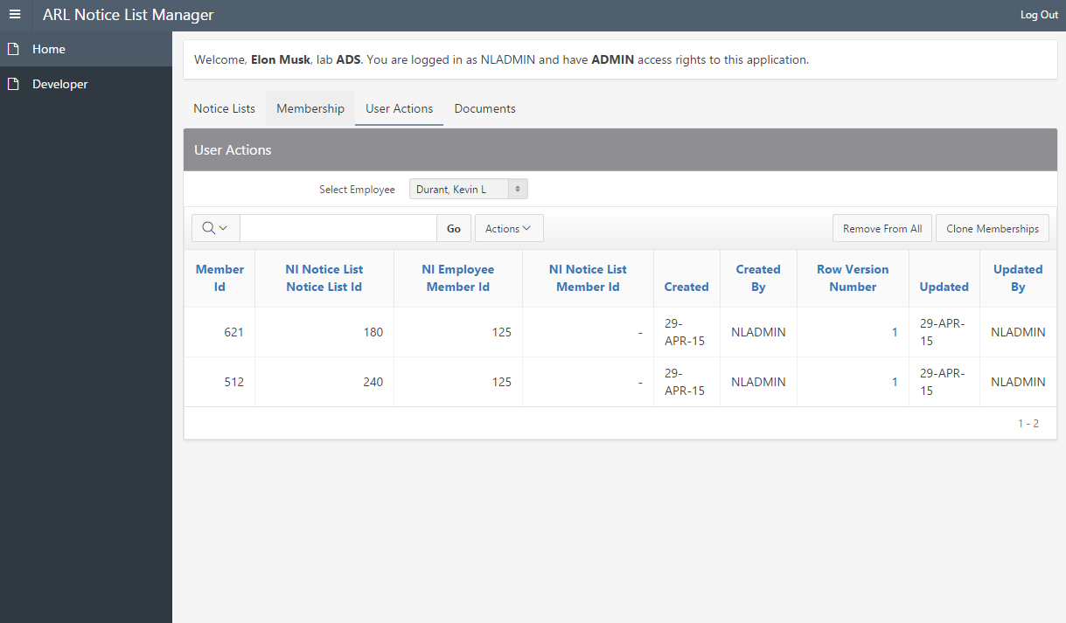
User Action Tab
Remove user from all lists
Clone user membership to another user
ADMINs can manage any user, STANDARD can only manage users in their lab

Slide 11
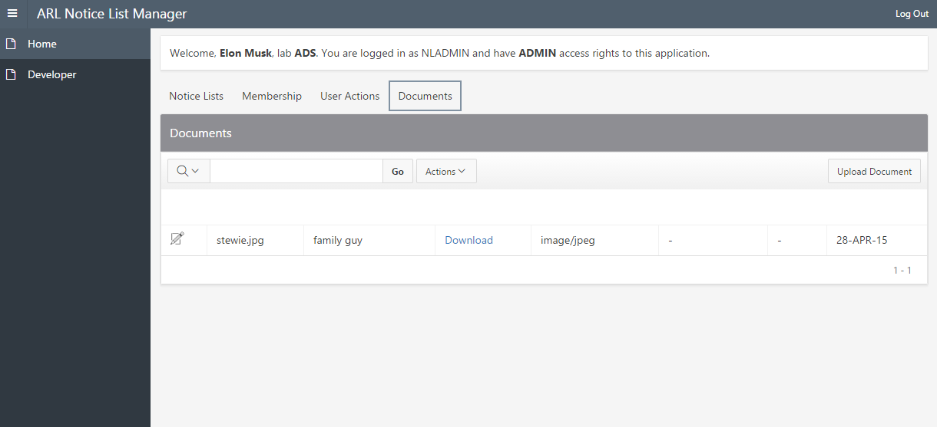
Documents Tab
ADMIN/STANDARD/BASIC users can upload documents associated to their NL_EMPLOYEE row

Slide 12
Known Bugs
MAJOR: Committing either of the shuttles clears the selection for the other shuttle. This appears to be an APEX issue as both of the submit processes are conditional on the specific button. Somehow during the commit, the page refresh is commiting the other shuttles selection when it’s in the intermediate step of just loading the full list of members (before the members are moved to the right side of the shuttle)
MINOR: Cloning memberships doesn’t filter out already existing memberships so you can get duplicate memberships
MINOR: Region display selector does not properly draw column names for all tabs when SHOW_ALL option is turned off. It will only show column names for the currently selected tab
MINOR: Tree control is ‘legacy’ and doesn’t support cascading LOVs. The only way to update it is to submit the page.
MAJOR: Cascading LOVs can’t reliably update the shuttle because the shuttle requires a secondary process to sort members into the right and left hand sides.

Slide 13
BACKUP SLIDES

Slide 14
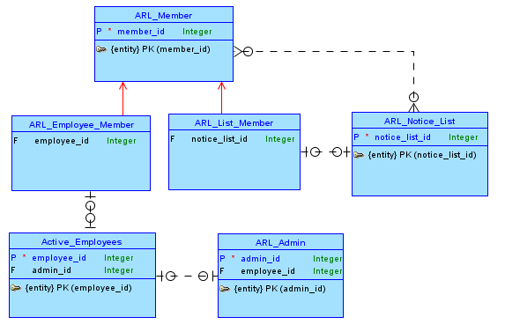
Conceptual Model B
Use inheritance to model “member” hierarchy
Downside is it creates a new member table that is unnecessary and can be simplified down to the same thing as logical model A (explained in next slide)

Slide 15
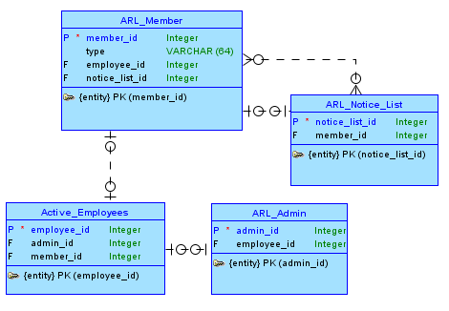
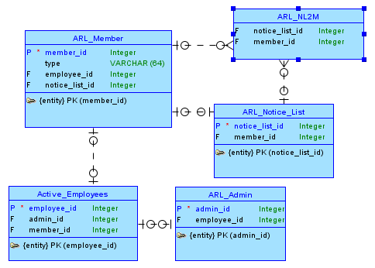
Logical Model B
Collapse the member hierarchy
Add junction table for M:N relationship
Notice that ARL_Member can be coalesced into ARL_NL2M and type can be made implicit by using employee_id OR notice_list_id. This change brings us back to logical model A. (It doesn’t seem like there are any downsides to doing this UNLESS we need to have views into the junction table to guarantee that the right id attribute is filled in.)
1
2
3

